Slide 1

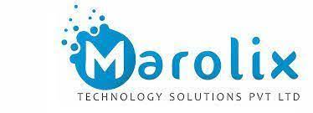
Breif Intro of DevOps, Jenkins & Pipeline project
Presented By
KRS Srinivas
(MT-0874)
Instructed By
Mrs. Jyothsna

Slide 2
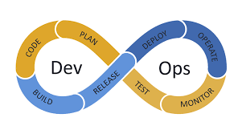
DevOps is all about ....
Addressing all traditional issues and implementing complete automation in every stage of software Development Life Cycle (SDLC) by using automation tools.

Slide 3
Jenkins
CI & CD
Whenever developers write code, we integrate all that code of all developers at that point of time and we build, test and
deliver/deploy to the client. This process is called CI & CD.
Key Terminology -
Integrate - Combines all codes to till some point.
Build - Compile the code and makes executable package.
Test - Tests whether application working properly or not.
Archive - Stores in an Artifactory repo for future use.
Deliver - Handing the product to client.
Deploy - Installing product in to client’s machine.

Slide 4







Jenkins - Work Flow
commit & Push
Build
Quality/Test
Delivery
Delivery
Storing Artifacts
Deploy

Slide 5
Jenkins
Job - It is a given set of tasks that runs sequentially as defined by user.
Types:
Freestyle - This is the default type and more flexible to configure.
Pipeline - It is the way of defining entire build process using code especially for long-running activities.
Maven Project - It helps to build Maven projects by installing Maven plugin.
Multi-Branch Pipeline - Automatically creating Jenkins pipelines based on source control branches i.e. scripted or declarative.
Multi-Configuration Project - It allows making multiple configurations for testing in multiple environments.

Slide 6
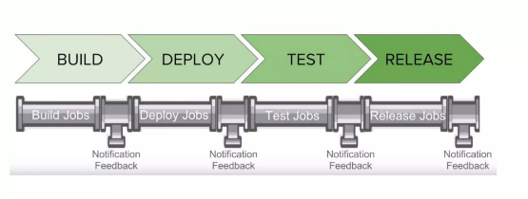
Jenkins Pipeline
In Jenkins, a pipeline is a group of events or jobs which are interlinked with one another in a sequence.
Node - Capable of Executing pipeline.
Stage - Distinct subset of Tasks performed through pipeline.
Step - It tells Jenkins what to do at a particular instance.

Slide 7
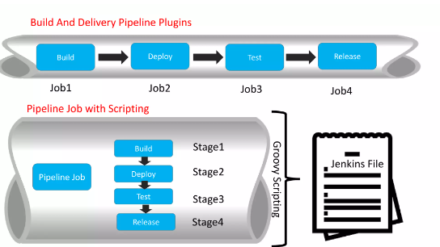
How many ways to do Pipeline project..?
Groovy script

Slide 8
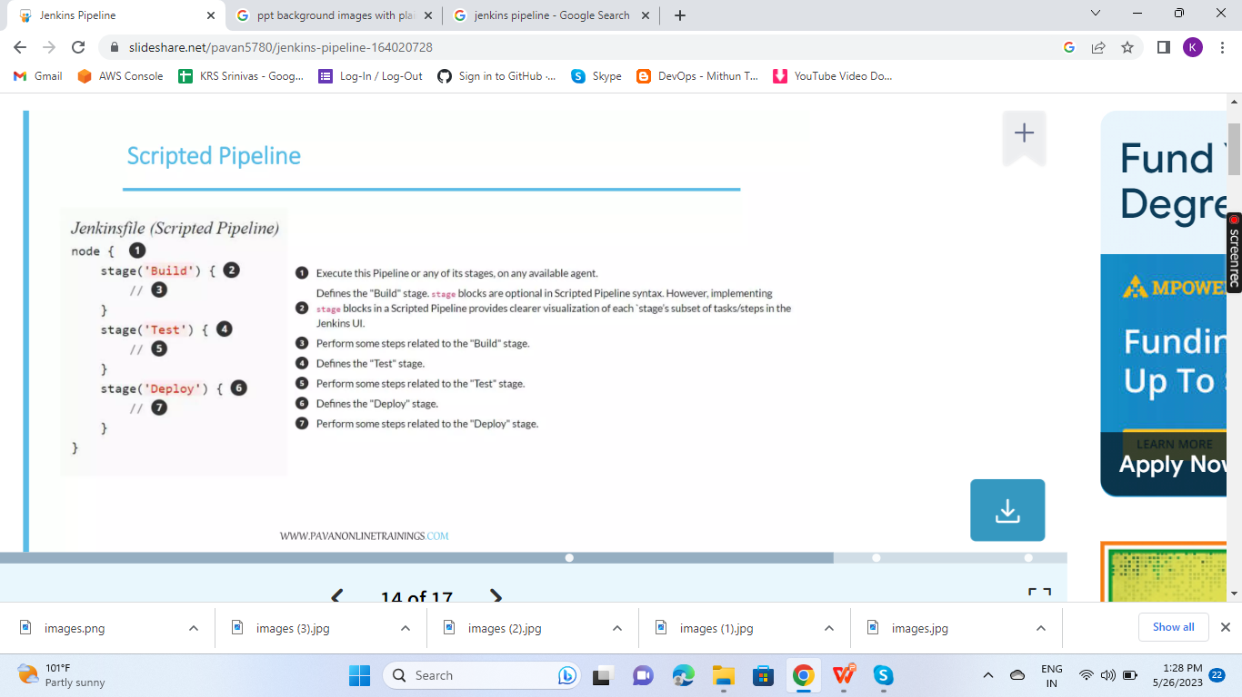
Scripted Pipeline

Slide 9
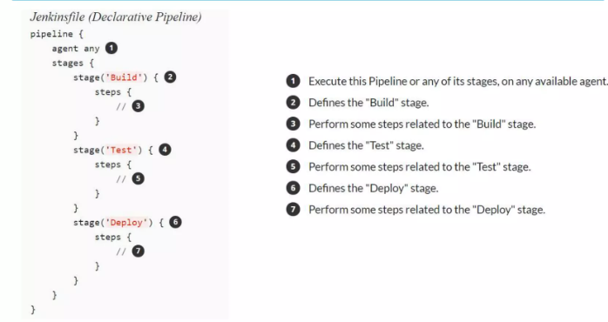
Declarative Pipeline

Slide 10
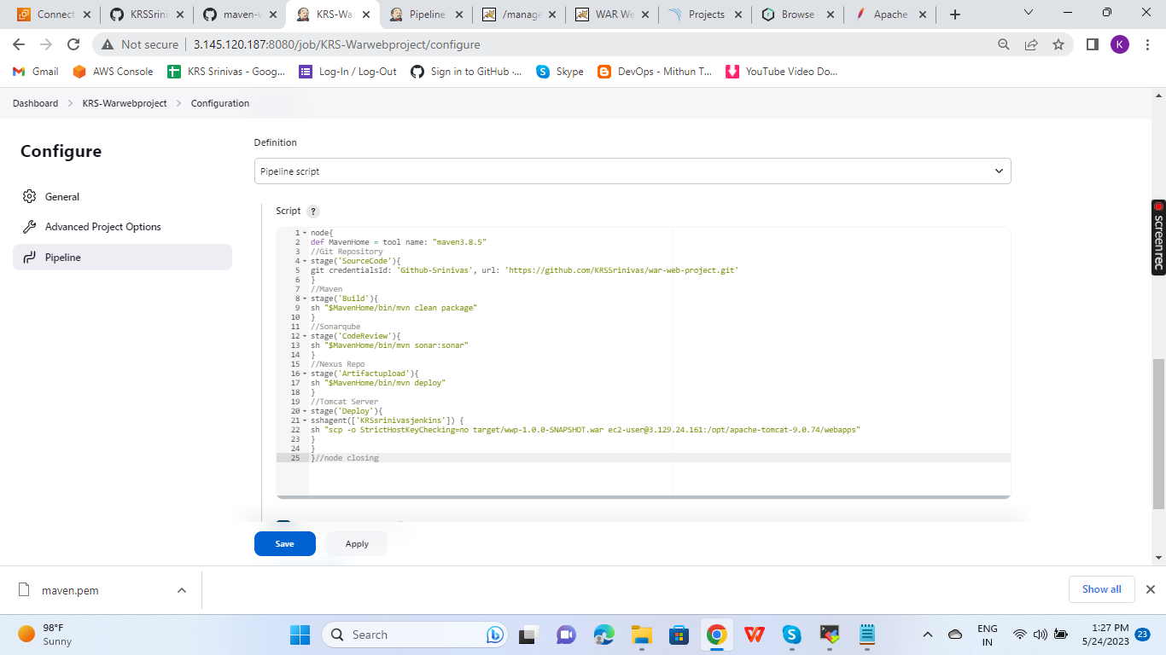
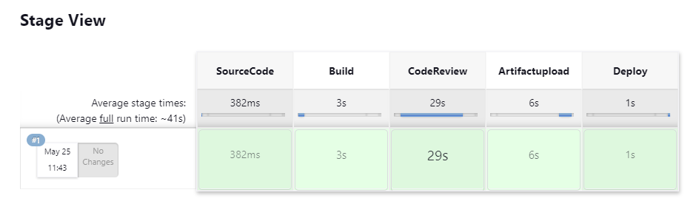
Script and build output

Slide 11

Any Queries...?

